Slide 1

Current State
01
Business Imperatives
02
Key Solution Characteristics
03
Conceptual Solution Architecture
04
Agenda

Slide 2

Out Understanding – Current State
CCODS currently being built for
Statements Efficiency
Card auto activation
Extension of promo rates
Current and future use cases primarily revolve around
Integration of insights into customer interactions via digital channels
Operational data access
Use Cases

Statements Efficiency use case nearing end of development
Patterns and technology stack have been proven out
Beginning work on integration with BRE for Auto Card Activation and Promo rate extension use cases
Current Status
Technology
Stack
Pivotal Cloud Foundry
Spring Boot based Microservices
Spring Batch
MongoDB
GraphQL

Slide 3

Additional business imperatives that need to be addressed as we move forward…
1
2
3
4
5
Time to Market Onboarding new datasets onto the ODS still requires long lead times
Vendor Dependency
Reliance on Fiserv to meet data needs prevents the business from operating with speed and agility
Inaccessible Data
80% of Data from Fiserv is locked away in CCHUB in EBCDIC format. This makes the data hard to access and analyze preventing the generation of operational and analytical insights.
Data Latency
Lack of real-time data feeds from Fiserv make certain operational and analytical use cases hard to implement
AI/ML Capabilities
No provision for incorporating home-grown or COTS analytical models to augment deterministic rules engine to generate data driven insights – these capabilities are needed to remain competitive.
Time To Market
Vendor Dependency
Inaccessible Data
Data Latency
AI/ML Capabilities

Slide 4




What our go-forward solution approach should account for….
Comprehensive Credit Cards Data and Message Model to support operational and analytical use cases
Inaccessible Data
Enabling holistic coverage
CCODS
Ingestion
Dynamic Metadata Driven ingestion of EBCDIC Data
Data Organization
Dynamic Metadata Driven transformation and organization of data
API
Generic and Dynamically instantiated data access APIs
Time to Market
Metadata Driven Approach
Real Time Data
Event Driven Architecture
Support Real Time Ingestion of Fiserv Data
Support propagation of business events to analytical applications in real-time
Integrate operational and analytical insights in real-time into digital channels
AI/ML Capabilities
AI/ML Decision Analytics
Data Science Workbench
Homegrown Models
COTS Models
Customer Insights
Marketing Insights
Partnership with servicing platform provider is critical as we embark on this journey

Slide 5








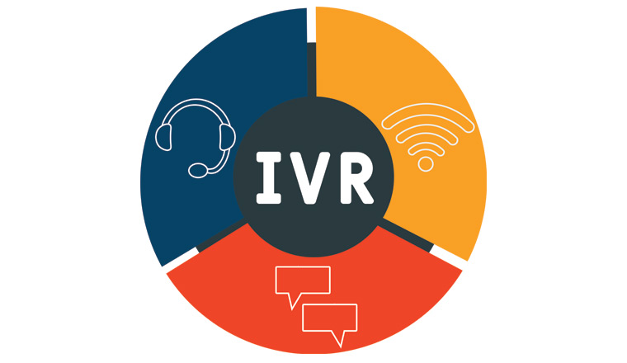
Conceptual Architecture to address business imperatives….
Data Acquisition
Data Sources
CCHUB
Meta Data Ingestion Framework
Batch
ACAPS
Streaming Adapter
Meta Data Driven Transformation
Other Data Sources
Real-time
High throughput, low latency message broker
Data Exploration
CCODS ( Operational Data Layer)
Insights Generation
CCODS
Analytical database
Customer
Account
API Wrapped Analytical Models ( AI/ML)
Embosser
Authorizations
Work Bench
Promotions
Rewards
Deterministic Rules Engine
Statements
Disputes
Data Distribution
Layer
Data API s
(Dynamically Instantiated)
Real-time Business Event Propagation
Analytical Insights API
Data Consumption
Layer
Channels
Data Analysts
Data Scientists
Applications
Operational Reporting
Operational Reporting
Case Management
Mobile
Web
IVR
Conversational UI

